Slide 1


Day 28
contact@anubhavtrainings.com
ABAP RESTFUL APPLICATION PROGRAMMING

Slide 2

Agenda – Day 28
Understanding Base Behaviour Definition
Implementation of Base Behaviour Definition
Create Projection CDS View for Processor
Create/Implement Behaviour Definition for Processor
Create Service Definition to Expose Entity
Implement Service Binding

Slide 3
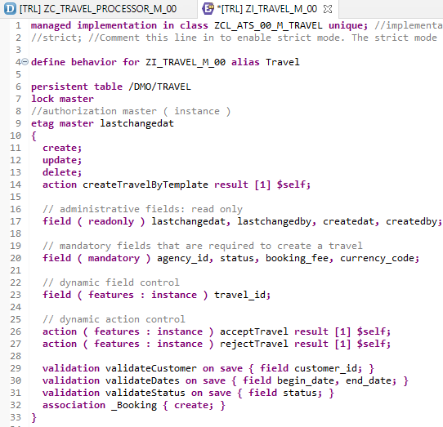
Implementing Base Behavior Definition
z
“ZI_TRAVEL_M_00”
Behavior Definition for Base CDS’s Views .

Slide 4
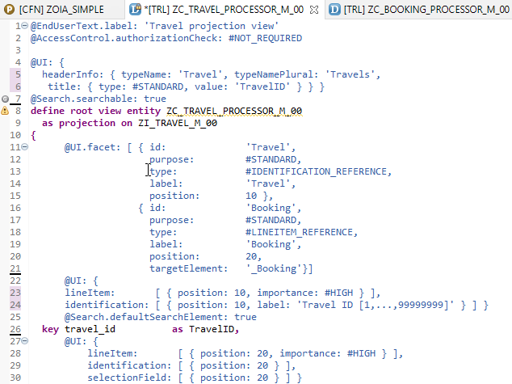
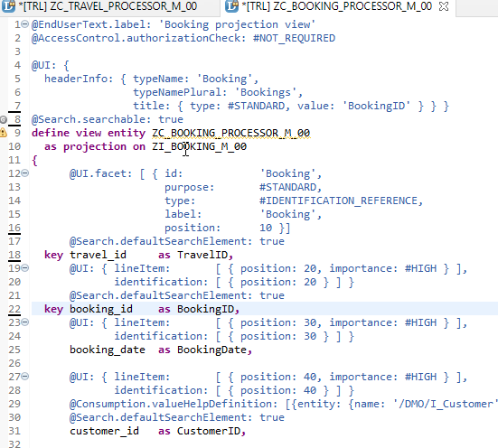
Projection CDS View’s for Processor
Projection CDS View for Travel Info “ZC_TRAVEL_PROCESSOR_M_00”
Projection CDS View for Booking Info “ZC_BOOKING_PROCESSOR_M_00”

Slide 5
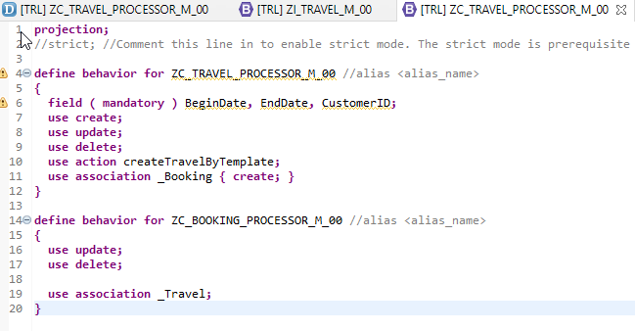
Behaviour Definition for Processor
“ZC_TRAVEL_PROCESSOR_M_00”
Behavior Definition for Projection CDS’s Views of Processor.

Slide 6
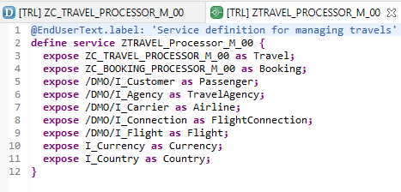
Service Definition
“ZTRAVEL_PROCESSOR_M_00”
Service Definition for Expose Entity

Slide 7
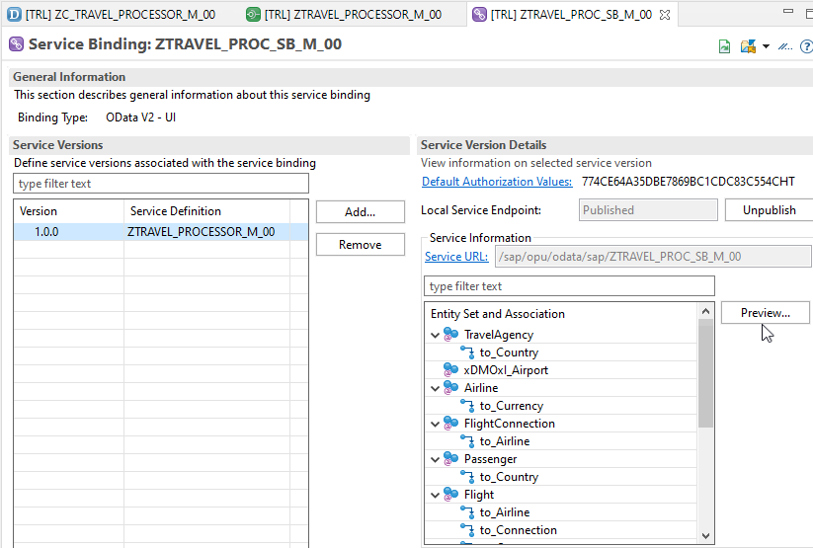
Service Binding (OData)
After Creating Service Binding , Select Entity and Click on Preview

Slide 8
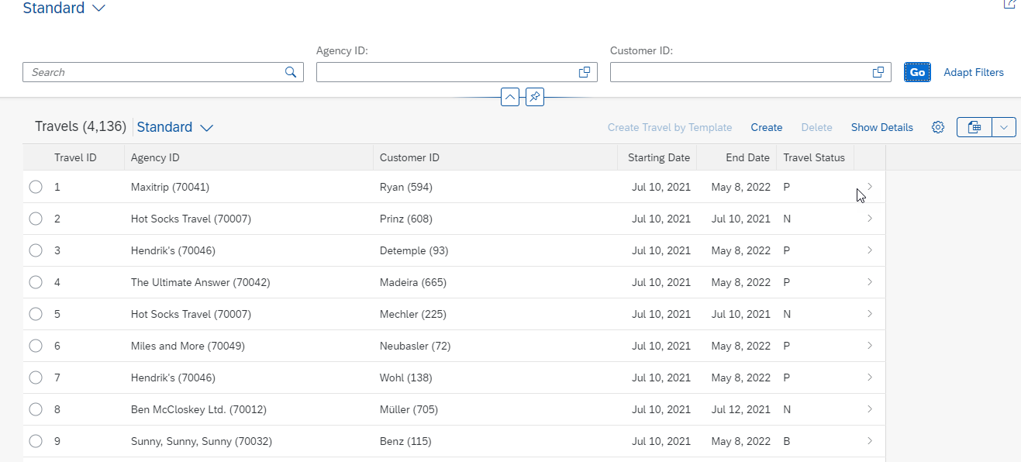
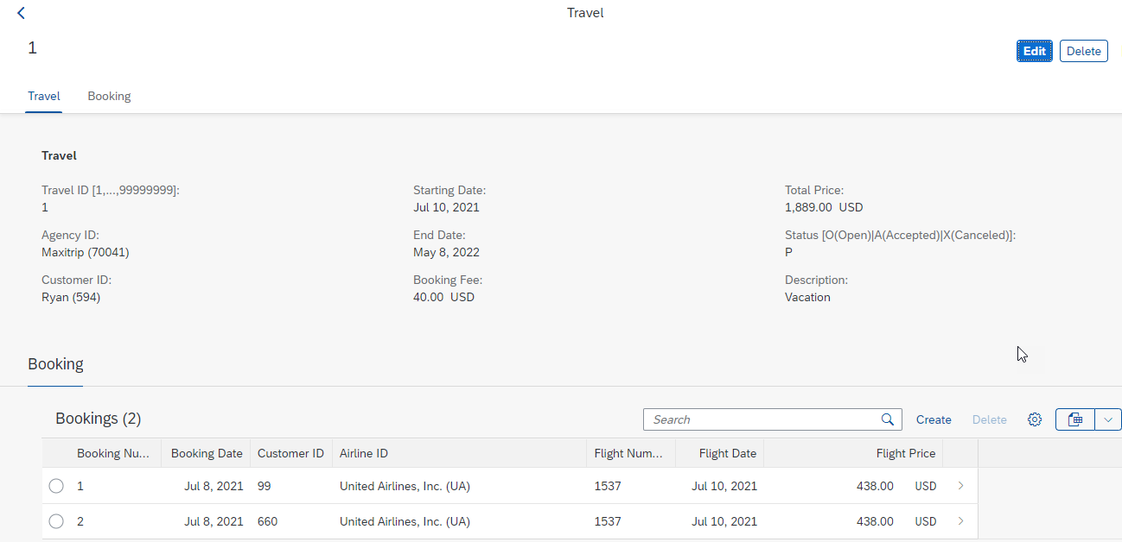
Final Result of Processor App
1st Screen with Search Bar & Filter Bar
2nd Screen with Travel and Booking Data,
& C-R-U-D Functionality

Slide 9

End of Day 28
Trainer: Anubhav Oberoy

Slide 10

Trainer: Anubhav Oberoy

Slide 11
THANK YOU
If you cannot do
great things, do small things in a great way.
Anubhav Oberoy
https://www.anubhavtrainings.com

Slide 12


We’re committed to empower you to be
Most Desirable Resource
through powerful training solutions.
We build the workforce of the future.
250+
Corporate Clients
30,000+
Learners Trained
25000+
Learners Placed
FREE WEBINARS
Sign up for free webinars with industry experts every fortnight!
Enroll Now!
Contact us today!
https://anubhavtrainings.com/

Slide 13




More from AnubhavTrainings.com

